Slide 1
ELEC40006: 1st Year Electronics Design Project 2020
Problem Definition:
Product Design Specification
Esther Perea
Room 614
e.perea@imperial.ac.uk

Slide 2
Outline
Definition of engineering design
Problem Definition phase
Total Design
Product Design Specification
32 elements
PDS document

Slide 3
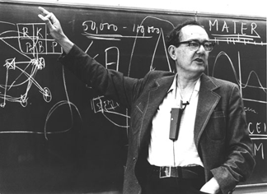
Definition of engineering design
“ To imagine and specify things that do not exist with the aim of bringing them into the world”
H. A. Simon
http://understandingsociety.blogspot.co.uk/2011/01/herbert-simons-satisficing-life.html
Notes:
– marketing, wishful thinking, technical invention, hunch, complaint about something that doesn’t work
– marketing, wishful thinking, technical invention, hunch, complaint about something that doesn’t work
– the man-made world –

Slide 4
Problem Definition
Problem definition
Customer Requirements
The purpose of this phase is to clarify “What does the client actually want?”
We translate “customer requirements “ (Project Brief) into “engineering terms” (specification)
A specification is the complete definition of the problem in specific qualitative and quantitative terms
Specification
Conceptual Designs
Generate many concept ideas
Preliminary Design
Select the one that best meets customer requirements
Detailed Design
Develop, verify and validate
Final Design

Slide 5
Problem Definition
Problem definition
Customer Requirements
Specification
Conceptual Designs
Generate many concept ideas
Preliminary Design
Select the one that best meets customer requirements
Detailed Design
Develop, verify and validate
Final Design

Slide 6
Problem definition
Probably the hardest phase for engineers
Particularly if under time constraints
Tendency to start solving the problem without knowing what it is (“Design now, fix it later”)
We believe that we know best and do not involve the customer
This will lead to false starts, increased risks and cost
The result might be a product that no one wants

Slide 7
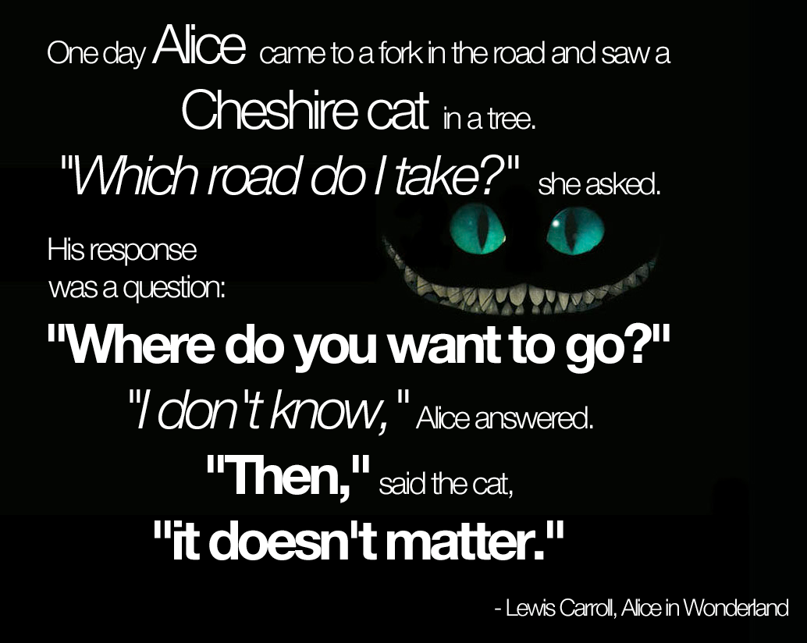
http://strategylab.ca/tag/quote/

Slide 8
If you don’t know where you are going, it is going to be difficult to get anywhere
We must set goals, have a direction or a general purpose
The more you know about where you are going, the easier making decisions throughout the journey will be

Slide 9
Starting point
Identify the need
What does the end user actually want / require
Translate their broadly defined “want” into more specific system or product – level (functional) requirements
Ask questions to define what is needed rather than how it will be achieved
Involve all stakeholders (customer, client, manufacturer, supplier, etc.) – team approach

Slide 10
What are the next steps?
Translate customer requirements into “engineering terms” (quantifiable)
We use the information from the problem definition phase
We compile Product Design Specification (part of the Total Design Methodology)

Slide 11
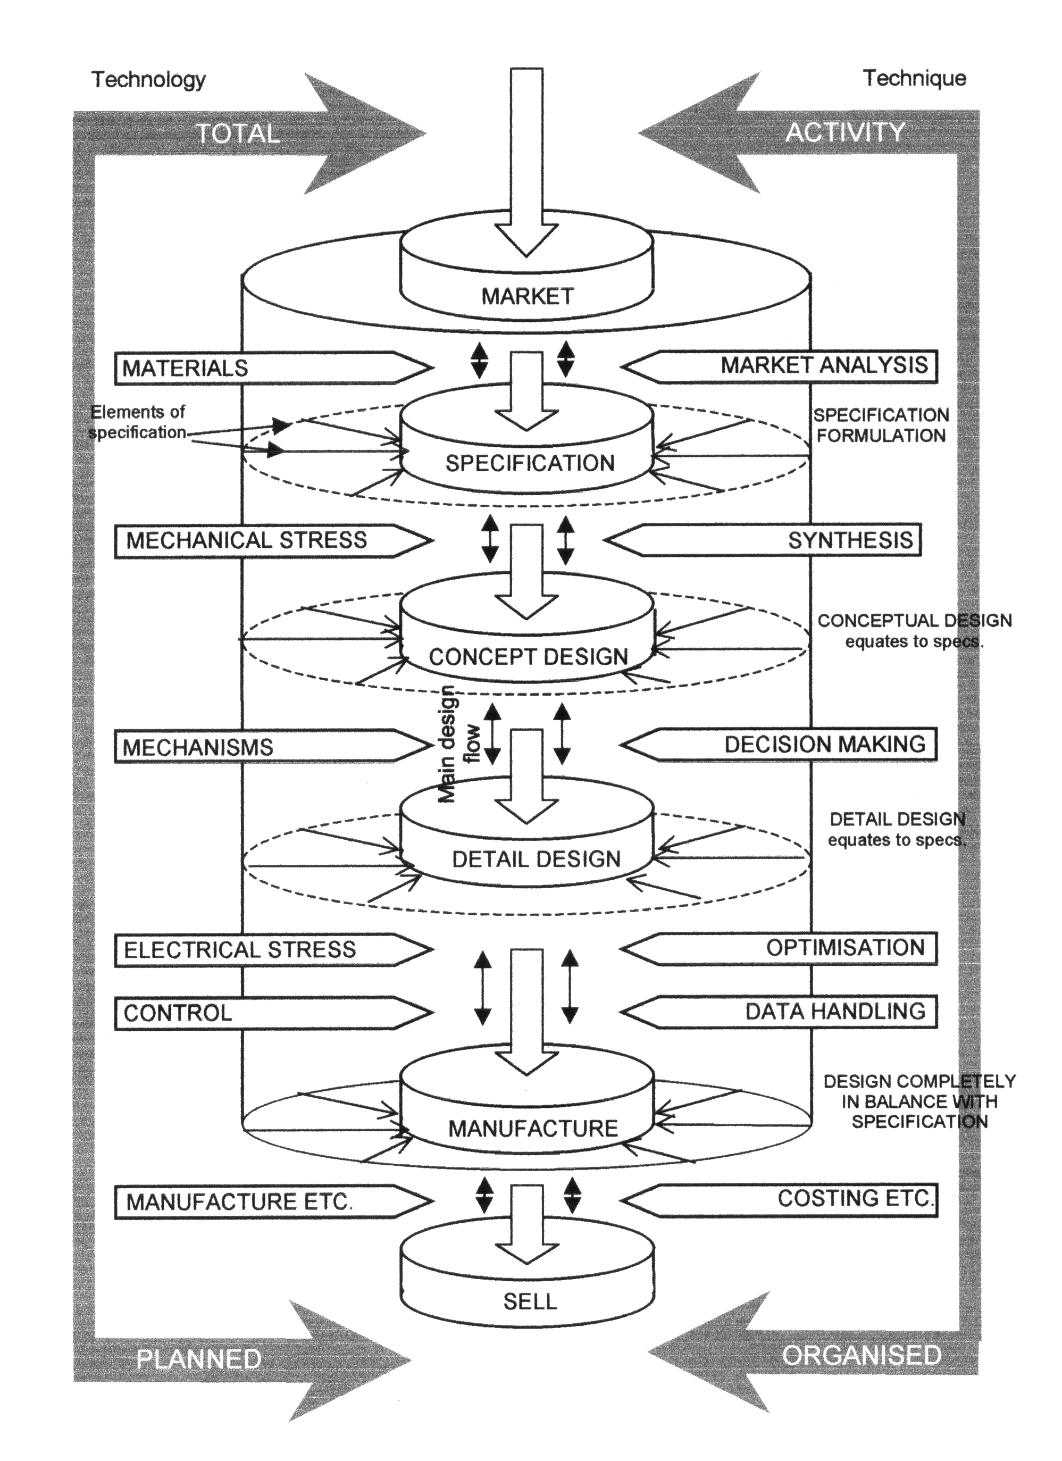
Total Design Methodology

Slide 12
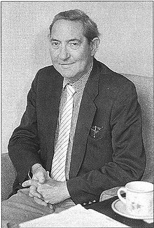
Total Design
Systematic activity involved between the identification of the user need and the successful selling of the product (designed to satisfy that need)
Encompasses product, processes,
people and organisation
Formalised by Stuart Pugh
http://en.wikipedia.org/wiki/Stuart_Pugh

Slide 13
Product Design Specification
A document that defines a product that does not yet exist
Specifies a problem, not a solution
Does not predict an outcome to the design process

Slide 14
Product Design Specification
Provides unique set of constraints for design
Lists all the conditions that the product must meet
(32 elements)
You should not eliminate any of the elements even if the information they provide overlaps with another one

Slide 15
PDS elements
Performance
Environment
Life in Service
Maintenance
Target Product Cost
Competition
Shipping
Packing
Quantity
Manufacturing Facility
Customer
Size
Weight
Materials
Product Life Span
Aesthetics, Appearance and Finish
Ergonomics
Standards and Specifications
Quality and Reliability
Shelf Life (storage)
Testing
Processes
Time Scale
Safety
Company Constraints
Market Constraints
Patents, Literature and Product Data
Legal
Political and Social Implications
Installation
Documentation
Disposal

Slide 16
Product Design Specification
It is a dynamic document – you should update it whenever new information is available
You will have a number of PDS versions by the time you finish your project
Comprehensive – pay attention to detail
Unambiguous – make no assumptions
Meticulous and thorough

Slide 17
The PDS document
Should be concise and clear. Aim to write at most a short paragraph for each element.
Use headings for the 32 elements as the starting point
Make it user friendly and easy to update
Refer to (and use) hand out

Slide 18
The PDS document
Try to quantify parameters for each of the elements as early as possible in the project
Not all 32 elements will apply to every project
Date the document and give it an version number (there will be many revisions)
Clearly document and communicate any changes you make to the rest of team
Should be the reference for everybody working on the project

Slide 19
Summary
Definition of engineering design
Problem Definition phase
Total Design
Product Design Specification
32 elements
PDS document

